Slide 1

TECHNICAL PRESENTATION
BIMAL PARAJULI (20BDS0405)

Slide 2
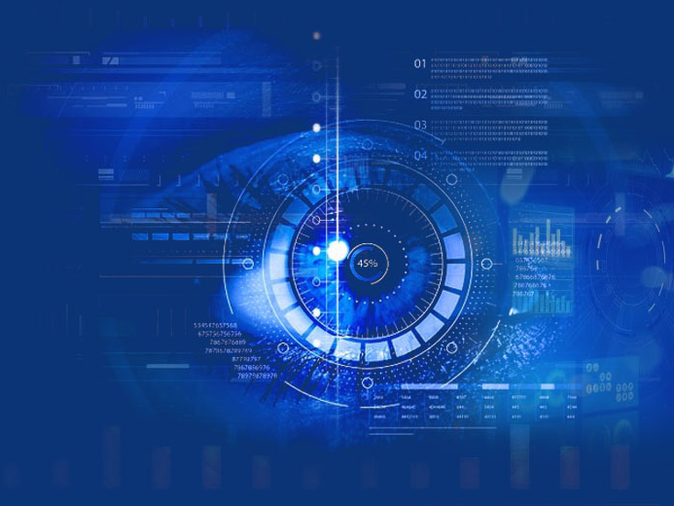
COMPUTER VISION

Slide 3

What is Computer Vision?

Slide 4
INTRODUCTION
Computer vision is an interdisciplinary scientific field that deals with how computers can gain high-level understanding from digital images or videos. From the perspective of engineering, it seeks to understand and automate tasks that the human visual system can do.
-Wikipedia

Slide 5
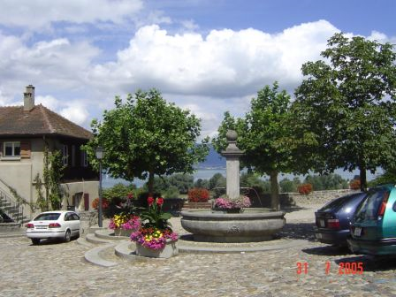
Computer Vision
Make computers understand images and video.
What kind of scene?
Where are the cars?
How far is the building?

Slide 6

Computer Vision incorporates:
Identifying the surroundings.
Recognizing the objects.
Identifying a person
Finding visual patterns.. etc

Slide 7
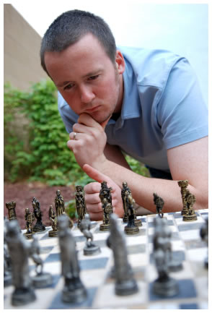
Vision is really hard
Vision is an amazing feat of natural intelligence
Visual cortex occupies about 50% of Macaque brain
More human brain devoted to vision than anything else
Is that a queen or a bishop?

Slide 8
Hardware and tools used:
Hardware:
Cloud based
Specially designed for image processing
Supports machine learning algorithms
Extremely powerful hardwares-billions of times faster than a normal computer.
Tools and software required:
OpenCV. This is a well-known library, a multi-platform tool which covers fundamental strategies and algorithms to play out image and video processing tasks. ...
Tensorflow. Google's ML and Deep Learning library is quite popular today. ...
Matlab. ...
CUDA. ...
Theano. ...
Keras.

Slide 9

Significance & Applications:

Slide 10
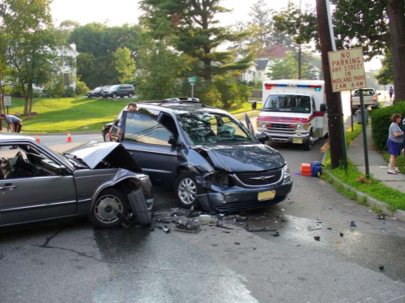
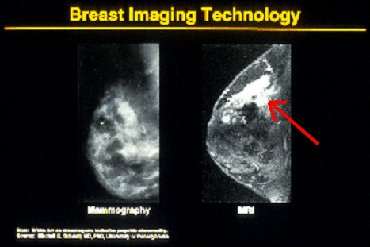


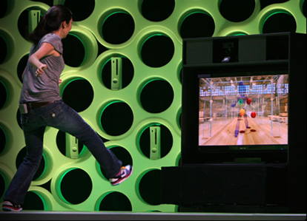
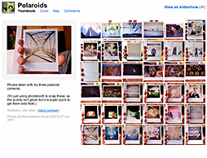
Why computer vision matters
Safety
Health
Security
Comfort
Fun
Access

Slide 11
How vision is used with computers..
Notes:
11

Slide 12
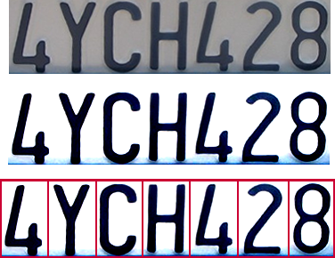

Optical character recognition (OCR)
Technology to convert scanned docs to text
Digit recognition, AT&T labs
http://www.research.att.com/~yann/
License plate readers
http://en.wikipedia.org/wiki/Automatic_number_plate_recognition
Notes:
12

Slide 13
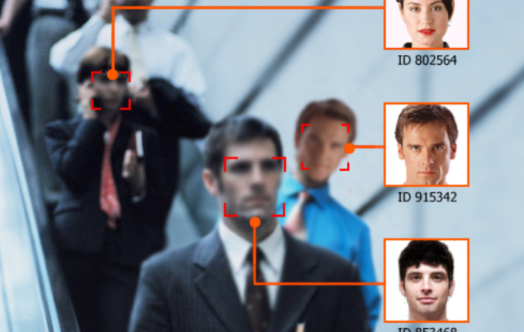
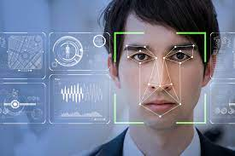
Face detection
Application of Face detection:
In digital photography to identify the persons in the photograph
In public places to track down burglars, thieves and trespassers.
Notes:
13
Why would this be useful? Main reason is focus. Also enables “smart” cropping.

Slide 14
Smile and facial expression detection
Sony Cyber-shot® T70 Digital Still Camera
Notes:
14

Slide 15
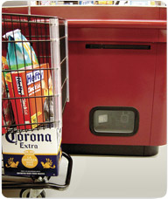
Object recognition (in supermarkets)
LaneHawk by EvolutionRobotics
“A smart camera is flush-mounted in the checkout lane, continuously watching for items. When an item is detected and recognized, the cashier verifies the quantity of items that were found under the basket, and continues to close the transaction. The item can remain under the basket, and with LaneHawk,you are assured to get paid for it… “
Notes:
15

Slide 16


Login without a password…
Face recognition systems are available now very widely in smart devices like phone, laptops and tablets that allows user to do touchless quick sign in.
Notes:
16

Slide 17
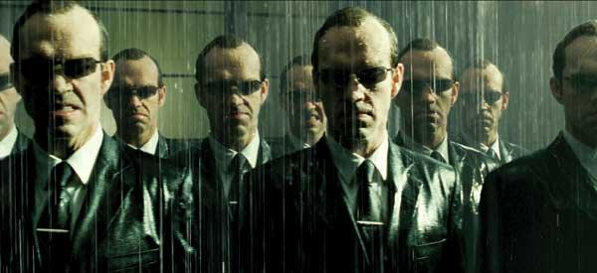
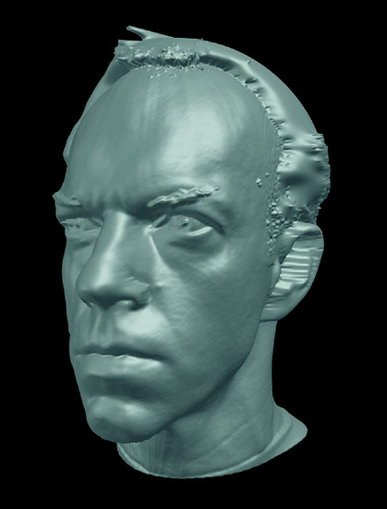
Special effects: shape capture
The Matrix movies, ESC Entertainment, XYZRGB, NRC
Notes:
17

Slide 18

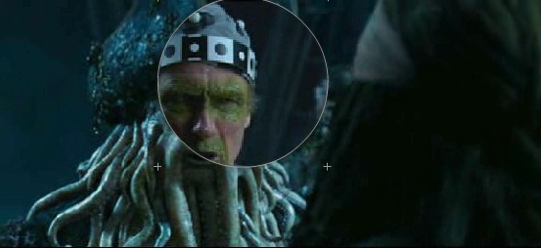
Special effects: motion capture
Pirates of the Carribean, Industrial Light and Magic
Notes:
18

Slide 19
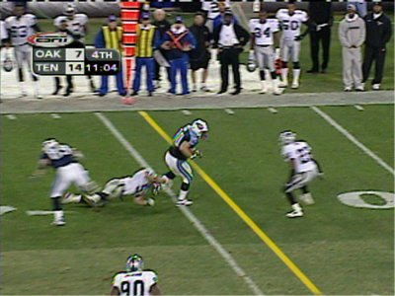
Sports
Sportvision first down line
Nice explanation on www.howstuffworks.com
http://www.sportvision.com/video.html
Notes:
19

Slide 20
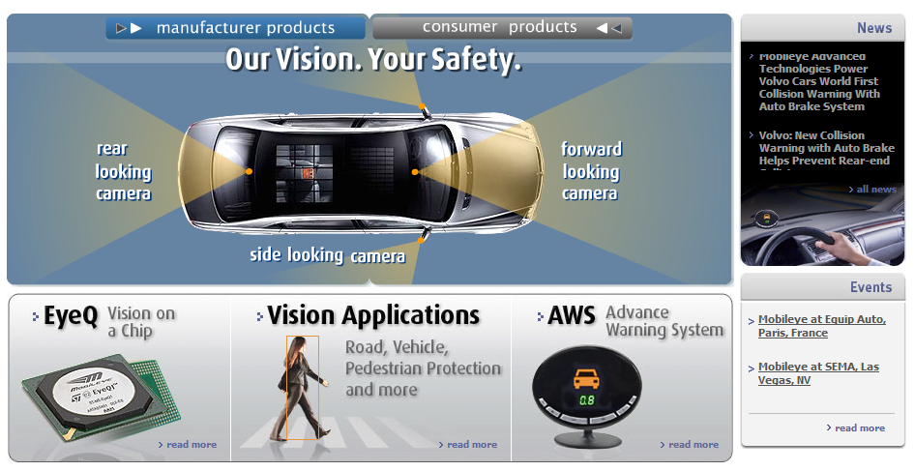
Smart cars
Slide content courtesy of Amnon Shashua
Mobileye
Vision systems currently in high-end TESLA, BMW, GM, Volvo models
Notes:
20

Slide 21
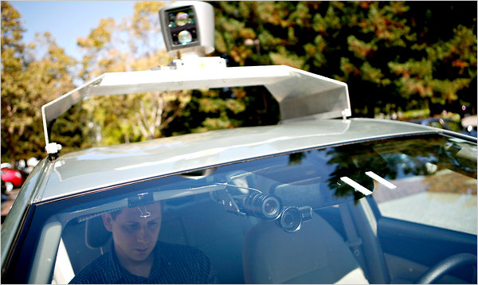
Google cars
http://www.nytimes.com/2010/10/10/science/10google.html?ref=artificialintelligence

Slide 22
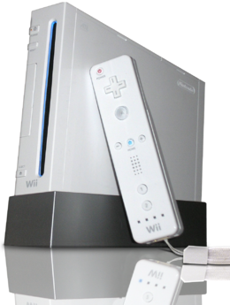
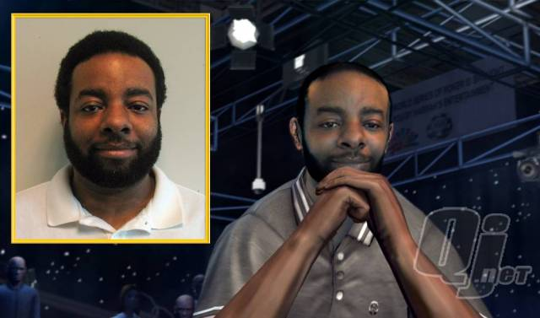
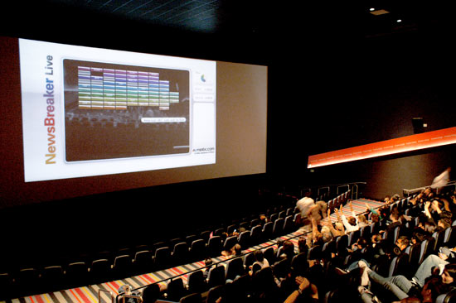
Vision-based interaction (and games)
Digimask: put your face on a 3D avatar.
Nintendo Wii has camera-based IR tracking built in. See Lee’s work at CMU on clever tricks on using it to create a multi-touch display!
“Game turns moviegoers into Human Joysticks”, CNET
Camera tracking a crowd, based on this work.
Notes:
22

Slide 23
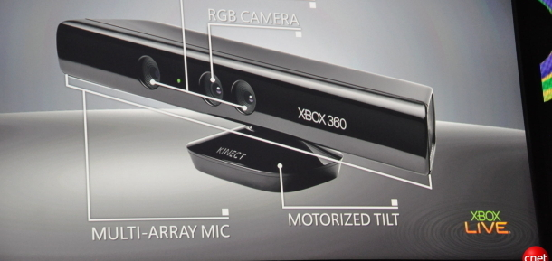
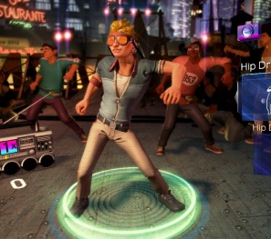
Interactive Games: Kinect
Object Recognition: http://www.youtube.com/watch?feature=iv&v=fQ59dXOo63o
Mario: http://www.youtube.com/watch?v=8CTJL5lUjHg
3D: http://www.youtube.com/watch?v=7QrnwoO1-8A
Robot: http://www.youtube.com/watch?v=w8BmgtMKFbY

Slide 24
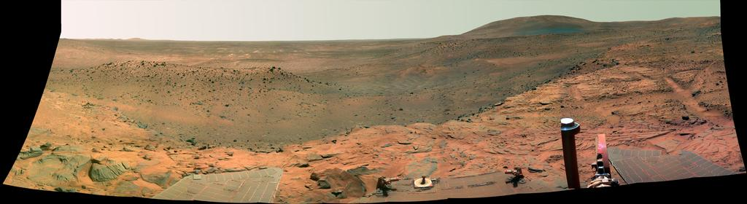
Vision in space
NASA'S Mars Exploration Rover Spirit captured this westward view from atop a low plateau where Spirit spent the closing months of 2007.
Vision systems (JPL) used for several tasks
Panorama stitching
3D terrain modeling
Obstacle detection, position tracking
For more, read “Computer Vision on Mars” by Matthies et al.
Notes:
24

Slide 25
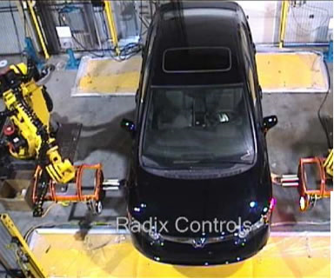
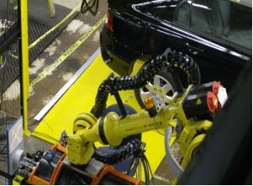
Industrial robots
Vision-guided robots position nut runners on wheels
Notes:
25

Slide 26
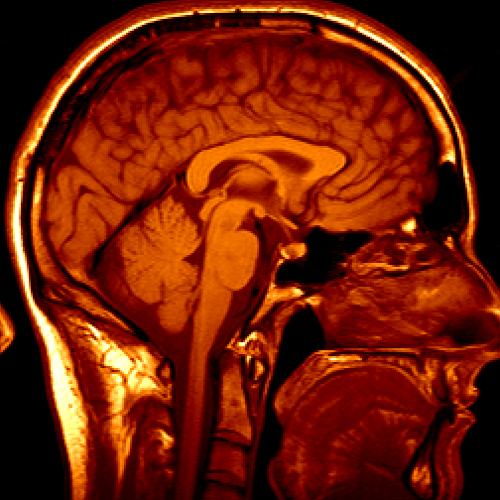
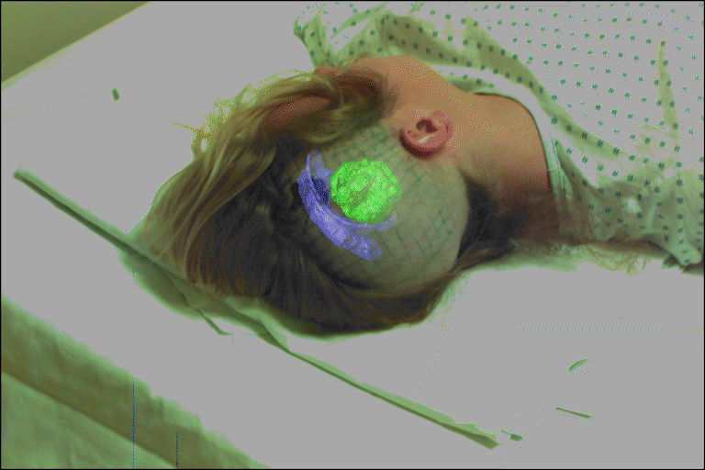
Medical imaging
3D imaging
MRI, CT
Image guided surgery
Grimson et al., MIT
Notes:
26

Slide 27
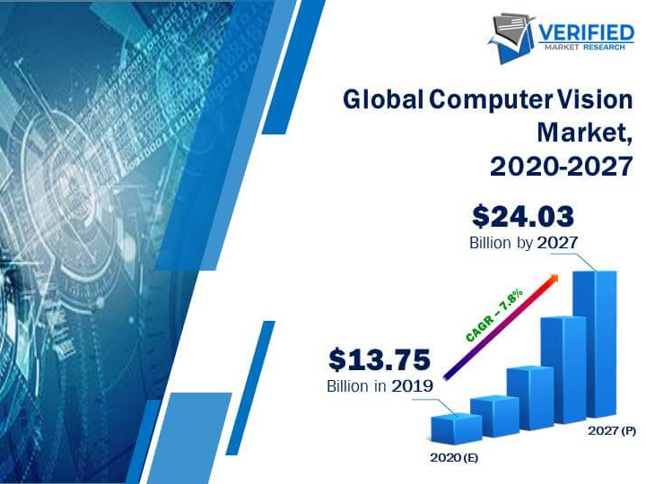
Future of computer vision
According to the market and markets report, the computer vision market is expected to rise to USD 17.4 billion by 2024 and 24.03 billion by 2027.
The vision-based robotic system and application-specific computer vision systems are expected to revolutionalize the workplace through its emerging technologies.

Slide 28
Conclusion:
So, computer visioin is a very promising field in modern technology and since it is still in a very young phase, we can expect a lot more development in upcoming years.

